Slide 1
Identifying differences in the omics of IR and IS prediabetics
Sabrina de Oliveira - I6155125
BMS Bachelor thesis 2020
Supervisors: Susan coort & martina kutmon
Bigcat
Maastricht university

Slide 2

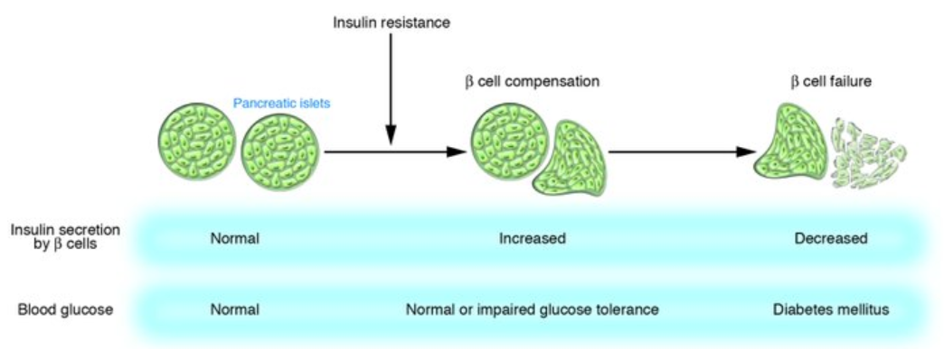

Introduction: T2DM
Importance:
2019: 463 million adults 2045: 700 million adults (1).
90-95% of all diabetes (2).
Pathophysiology:
51%
(3)
https://www.jci.org/articles/view/29189/figure/1
Notes:
Pathophysiology:
https://www.ncbi.nlm.nih.gov/pmc/articles/PMC4226760/
https://www.emjreviews.com/diabetes/article/editors-pick-how-can-we-develop-more-effective-strategies-for-type-2-diabetes-mellitus-prevention-a-paradigm-shift-from-a-glucose-centric-to-a-beta-cell-centric-concept-of-diabetes/
T2DM is generally believed to develop after the onset of insulin resistance due to the beta cell dysfunction that results from the increased need for insulin secretion. This beta cell dysfunction is especially relevant since no production of new beta cells occurs past the age of 30 in the human pancreas. Hence, insulin resistance is believed to be a critical step in the development of T2DM. For this reason, great efforts are being made in order to investigate factors that influence insulin sensitivity.

Slide 3


Introduction: IR at the omics level
Host Metabolome
Microbial Metagenome
Host Proteome
↓ Bacteroidetes/Firmicutes
ratio in T2D. (4)
Genetic
predisposition (6)
Hypertriglyceridemia (5)
Unrestrained
gluconeogenesis (5)
IR
IR
IR
$↑$ BCAA
Specific taxa = associated
with improved insulin
sensitivity or with insulin resistance (9)
Differential expression
of genes involved in
BCAA catabolism (7)
Notes:
Nevertheless, this interaction is still poorly understood and the changes in the omics of type 2 diabetic individuals remain debatable, especially in the time-period prior to diabetes onset.

Slide 4

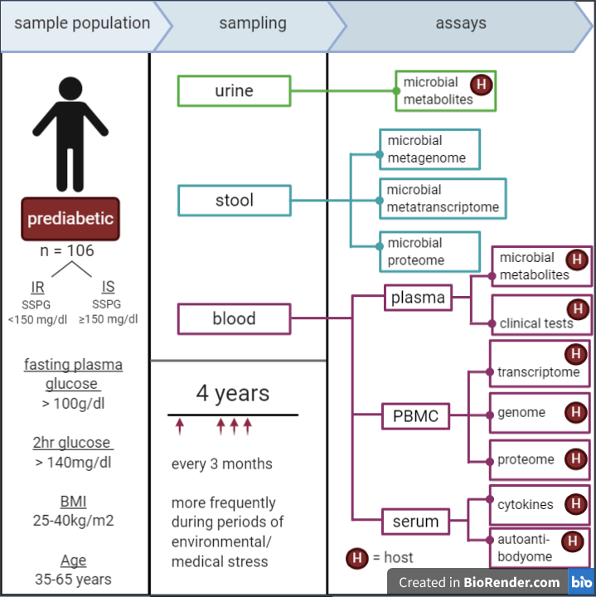
Aim
Investigate the changes in microbiome, host metabolome and host proteome between insulin resistant and insulin sensitive prediabetics.
Sample population and general sampling protocol of the iHMP’s T2DM project. PBMC = peripheral blood monocytes. Figure adapted from an iHMP Research Network Consortium publication (4).

Slide 5








Methods
Proteome data
Metabolome data
Metagenome data
iHMP T2DM data
Pre-processing
Isolated analysis of each omic
Combined analysis
Pathway analysis
(PathVisio & MetaboAnalyst)
Network Analysis
(Cytoscape)
60 subjects:
28 = IS
32 = IR
Subject data
Classification and data availability
Differential Analysis
(limma package)
Average per subject
Differential Analysis
(MetaboDiff package)
Average per subject
only HMDB included
Combined analysis
Filtering taxa (NA ranks & prevalence)
PCA
PERMANOVA
Homogeneity check
Top taxa
Phyla abundances
PCoA
Incl. samples in both
Excl. of outliers
Sparse CCA

Slide 6

PART Ia
Metagenome data
402 samples
362 taxa

Slide 7
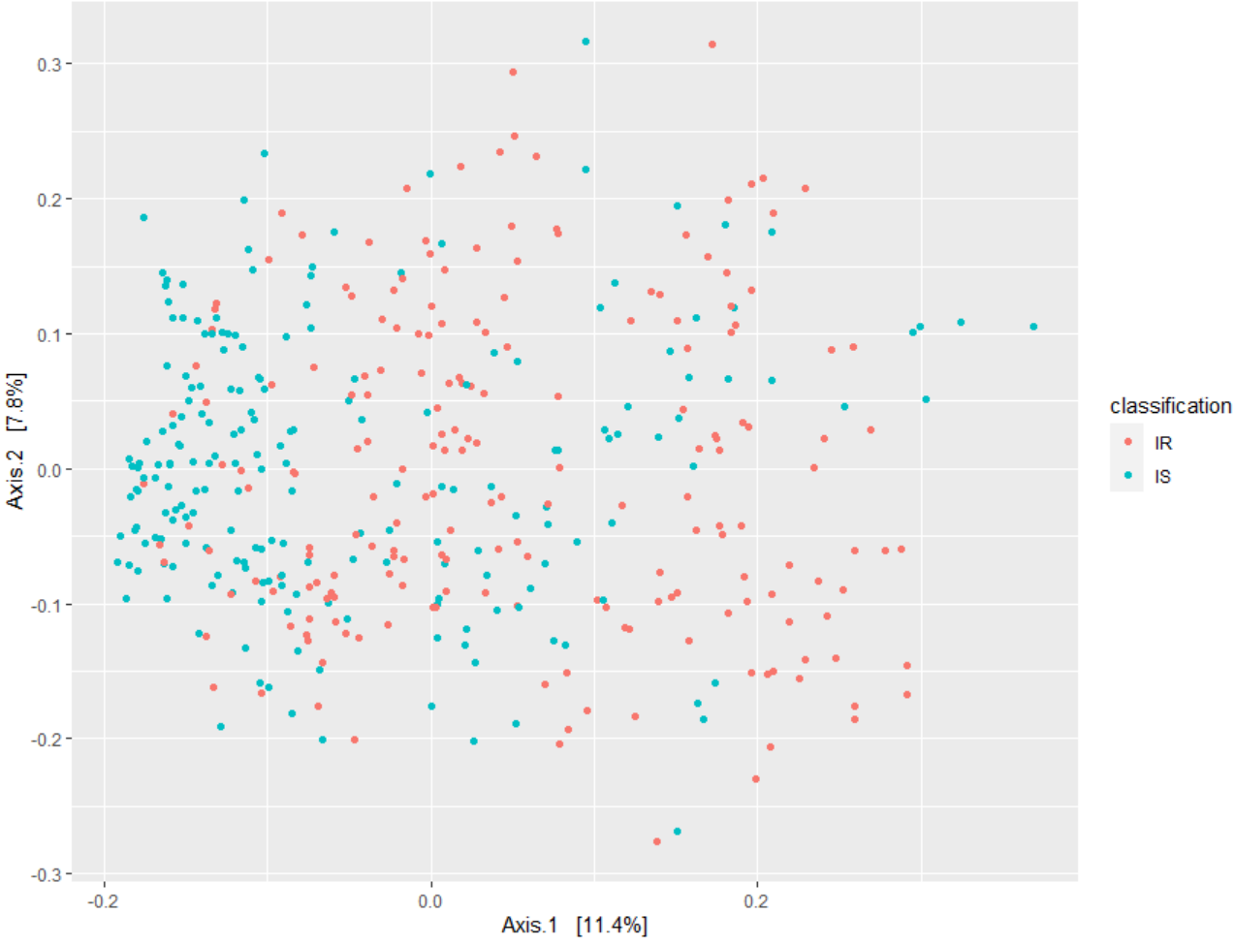
Results: PCoA with Bray Curtis dissimilarity Is there metagenomic separation between IR and IS?
17
All points = samples
Notes:
Check if groups are homogenous based on p-value!

Slide 8
Results: PERMANOVA Is this separation significant?
17
YES!
p = 0.010
Conclusion
The IR group likely has a distinct microbiome from the IS group.
BUT there also seems to exist differences within each group.
Notes:
adonis works by first finding the centroids for each group and then calculates the squared deviations of each of sample to that centroid. Then significance tests are performed using F-tests based on sequential sums of squares from permutations of the raw data. (https://chrischizinski.github.io/rstats/adonis/)
This could be due to subject characteristics that were not taken into account during the study, such as ethnicity.

Slide 9
Results: Homogeneity check What could explain this separation?
17
Could this separation be explained by different variances of the groups?
Method: Analysis of multivariate homogeneity of group variances (betadisper)
Result: p = 1.171
Conclusion
The metagenomic separation is unlikely to be the result of unequal variances between the 2 groups.
Notes:
adonis works by first finding the centroids for each group and then calculates the squared deviations of each of sample to that centroid. Then significance tests are performed using F-tests based on sequential sums of squares from permutations of the raw data. (https://chrischizinski.github.io/rstats/adonis/)
This could be due to subject characteristics that were not taken into account during the study, such as ethnicity.

Slide 10
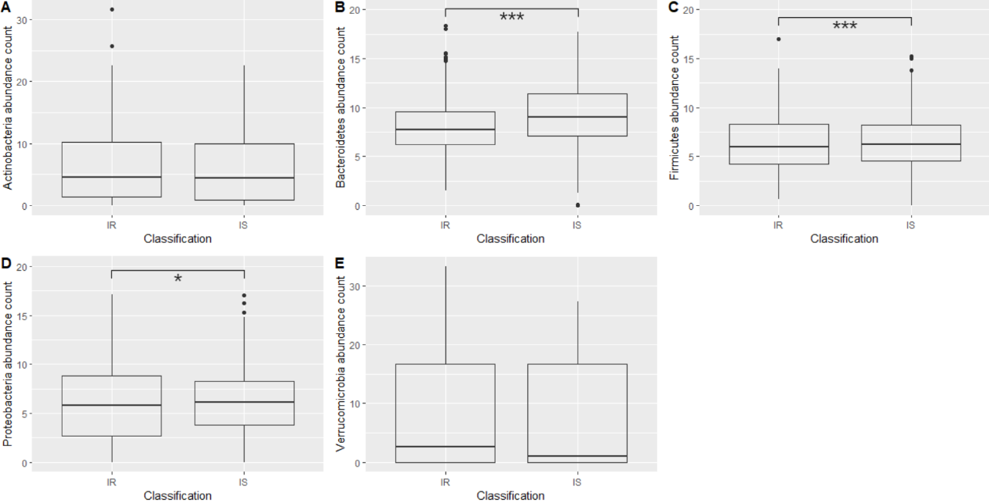
Results: Phyla abundances What could explain this separation?
11

Slide 11
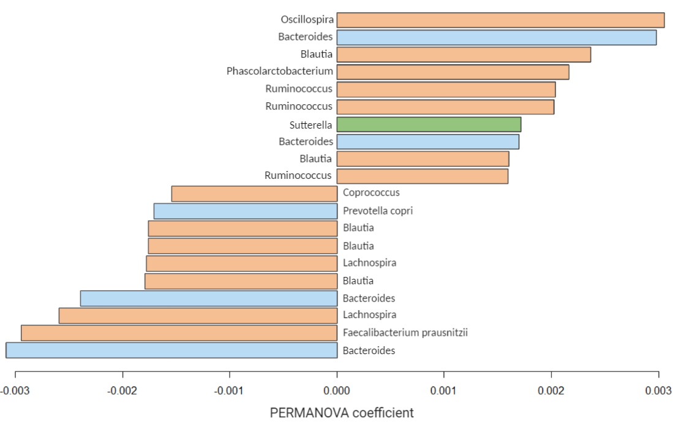
Results: Contributing microbes What could explain this separation?
11
Firmicutes
Bacteroidetes
Proteobacteria
More abundant in IR
Genus of microbes contributing the most to the metagenomic separation:
Oscillospira (phylum Firmicutes): more abundant in IR.
Bacteroides (phylum Bacteroidetes): less abundant in IR.
Less abundant in IR
Bar plot of the OTUs generated by the PERMANOVA deemed to contribute the most to the separation between the IS and IR groups.
For each OTU, the corresponding genus and species (if available) is given.
Notes:
PERMANOVA coefficient = the squared deviations of each of sample to the centroid of each group.

Slide 12
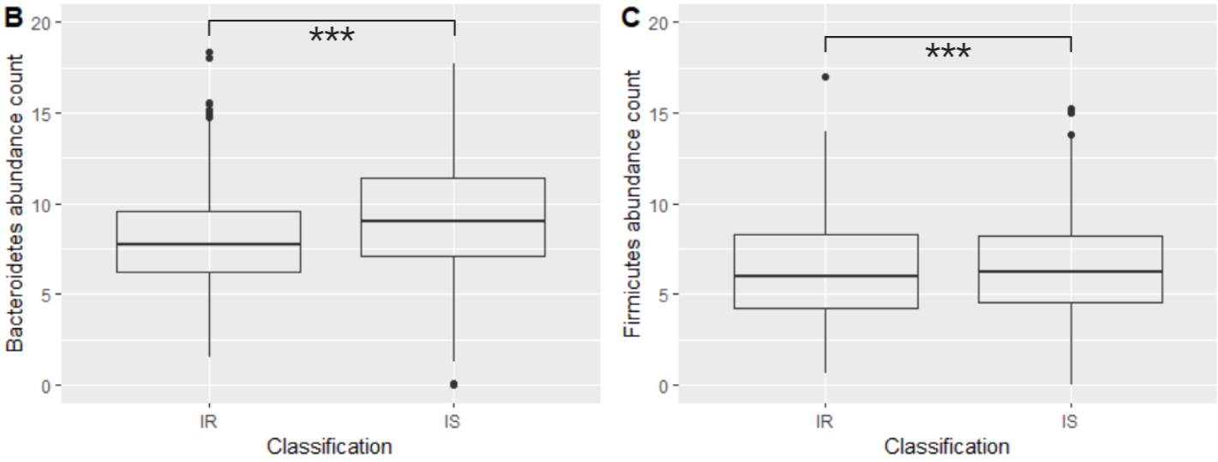

Discussion: Bacteroidetes/Firmicutes
11
↓ Bacteroidetes/Firmicutes
ratio in T2D. (4)
BUT very small change
Why?
↓ Bacteroidetes/Firmicutes ratio in obesity. (reference)
iHMP data: BMI = 25-40kg/m2
Conclusion
Small change could be due to the IS subjects also being obese, however, this small change does show an effect of IR independent of BMI.

Slide 13
PART Ib
18
Metabolome data
Metagenome data
323 metabolites
402 samples
362 taxa

Slide 14

Results: sparse CCA
19
Features best explaining the covariation between the metabolomic and metagenomic data
13 microbes
All = Firmicutes.
6 = Faecalibacterium prausnitzii (↓ in IR)
3 = Oscillospira ($↑$ in IR).
2 = Coprococcus (↓ in IR).
11 metabolites
10 = monoacylglycerols with 1 of these being 2-arachidonoylglycerol (2-AG).
Remaining 1 = arachidonic acid.
Do these metabolites have a significantly different abundance between the 2 conditions?
Notes:
This method compares sets of features across high-dimensional data tables, where there may be more measured features than samples. In the process, it chooses a subset of available features that capture the most covariance – these are the features that reflect signals present across multiple tables.
https://www.bioconductor.org/help/course-materials/2017/BioC2017/Day1/Workshops/Microbiome/MicrobiomeWorkflowII.html#graph-based_analyses

Slide 15

PART II
Proteome data
Metabolome data
686 samples
302 proteins
726 samples
323 metabolites

Slide 16

Results: Differential Analysis
What proteins/metabolites have sig. different abundances between IR and IS?
Proteomic
Metabolomic
Limma package
MetaboDIff package
P-value < 0.05: 23 proteins
P-value < 0.05: 40 metabolites
APOC4
↓APOD
↓ APOA1
APOF
CFH
VTN
IL1RAP
C1QB
C4A
HP
LPA
2-AG
DHA
L-glutamate
Pyroglutamic acid
Hexanoylcarnitine
3-hydroxydodenoic acid
Ethylmalonic aci d
Immune function
Lipid homeostasis
Energy homeostasis

Slide 17

Results: Combined Pathway Analysis
What pathways are most likely altered in IR compared to IS?
PathVisio
Expression criterion: p < 0.05
MetaboAnalyst
KEGG (2019)
Pathway | Hits | logFC
IL-1 signalling | IL1RAP | -0.302
Signal transduction through IL1R | IL1RAP | -0.302
Structural Pathway of IL-1 | IL1RAP | -0.302
Thermogenesis | 2-AG | -0.758
PPAR alpha pathway | APOA1 PLTP | -0.301 -0.458
Pathway | Hits | logFC
Nitrogen metabolism | L-Glutamate | 0.288
D-Glutamine and D-glutamate metabolism | L-Glutamate | 0.288
Immune function
Lipid homeostasis
Energy homeostasis
Notes:
CHECK 15 METABOLITES? WHY NOT 40?

Slide 18
Results: Combined Pathway Analysis
What pathways are most likely altered in IR compared to IS?
PathVisio
Expression criterion: p < 0.05
MetaboAnalyst
KEGG (2019)
Pathway | Hits | logFC
IL-1 signalling | IL1RAP | -0.302
Signal transduction through IL1R | IL1RAP | -0.302
Structural Pathway of IL-1 | IL1RAP | -0.302
Thermogenesis | 2-AG | -0.758
PPAR alpha pathway | APOA1 PLTP | -0.301 -0.458
Pathway | Hits | logFC
Nitrogen metabolism | L-Glutamate | 0.288
D-Glutamine and D-glutamate metabolism | L-Glutamate | 0.288
Why use both?
Allows for a more detailed picture of the altered biological pathways.
Notes:
CHECK 15 METABOLITES? WHY NOT 40?

Slide 19

Discussion: Combined Pathway Analysis
Problem: all these pathways only contained 1-2 hits.
Are these pathway alterations large enough to result in noticeable differences between the IR and IS group?
Debateable, due to low coverage.
Possible solution: 1 tool with coverage of WikiPathways, KEGG and Reactome.
Notes:
CHECK 15 METABOLITES? WHY NOT 40?

Slide 20

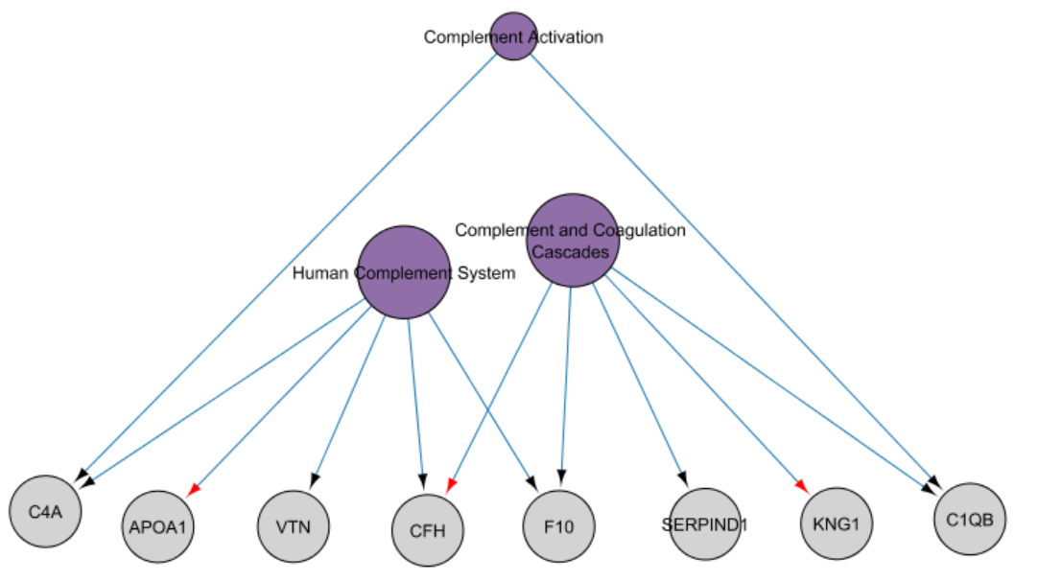
Results: Network Analysis
Conclusion
The immune system is likely to be altered in the IR compared to the IS based on differences in proteomics.
Pathways = purple, proteins (HGNC annotation) = grey.
Size of the pathway nodes represents their out-degree size.

Slide 21

What about the biological implications of the metagenomic differences?
22
Now that we know which metabolites are sig. altered in IR compared to IS, we can look at the sparse CCA more critically.

Slide 22

Discussion: sparse CCA
19
Host metabolome-microbiome interaction
13 microbes
All = Firmicutes.
6 = Faecalibacterium prausnitzii (↓ in IR)
3 = Oscillospira ($↑$ in IR).
2 = Coprococcus (↓ in IR).
11 metabolites
10 = monoacylglycerols with 1 of these being 2-arachidonoylglycerol (2-AG).
Remaining 1 = arachidonic acid.
↓ in IR
Conclusion
The lower abundance of F.prausnitzii in IR may explain the lower 2-AG levels since it may be an indication of low A. muciniphila.
Cross-fed by Akkermansia muciniphila
Notes:
This method compares sets of features across high-dimensional data tables, where there may be more measured features than samples. In the process, it chooses a subset of available features that capture the most covariance – these are the features that reflect signals present across multiple tables.
https://www.bioconductor.org/help/course-materials/2017/BioC2017/Day1/Workshops/Microbiome/MicrobiomeWorkflowII.html#graph-based_analyses
Red box = problem with this conclusion.
Future perspectives.

Slide 23
Conclusions
22
sss

Slide 24
References
International Diabetes Federation. IDF Diabetes Atlas, 9th edn. Brussels, Belgium: 2019. Available at: https://www.diabetesatlas.org
American Diabetes Association. 2. Classification and diagnosis of diabetes: standards of medical care in diabetes—2019. Diabetes Care. 2019 Jan 1;42(Supplement 1):S13-28
Saisho Y. How Can We Develop More Effective Strategies for Type 2 Diabetes Mellitus Prevention? A Paradigm Shift from a Glucose-Centric to a Beta Cell-Centric Concept of Diabetes. DIABETES. 2018 Nov.
Integrative HM. The Integrative Human Microbiome Project: dynamic analysis of microbiome-host omics profiles during periods of human health and disease. Cell host & microbe. 2014 Sep 10;16(3):276.

Slide 25
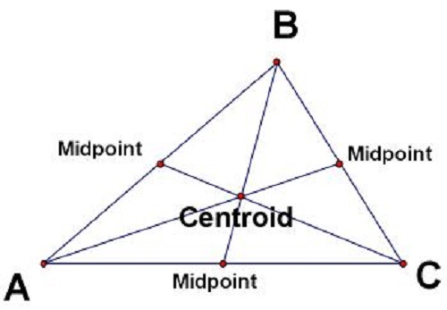
the centre of mass of a geometric object of uniform density.
http://www.differencebetween.net/science/difference-between-centre-of-gravity-and-centroid/

Slide 26
Discussion: Bacteroidetes/Firmicutes
11
Firmicutes
More abundant in IR
↓ Bacteroidetes/Firmicutes
ratio in T2D. (4)
Less abundant in IR
Bacteroidetes
Conclusion
Given the sample population, may be better to investigate the metagenomic differences at a level more specific than phylum.

Slide 27
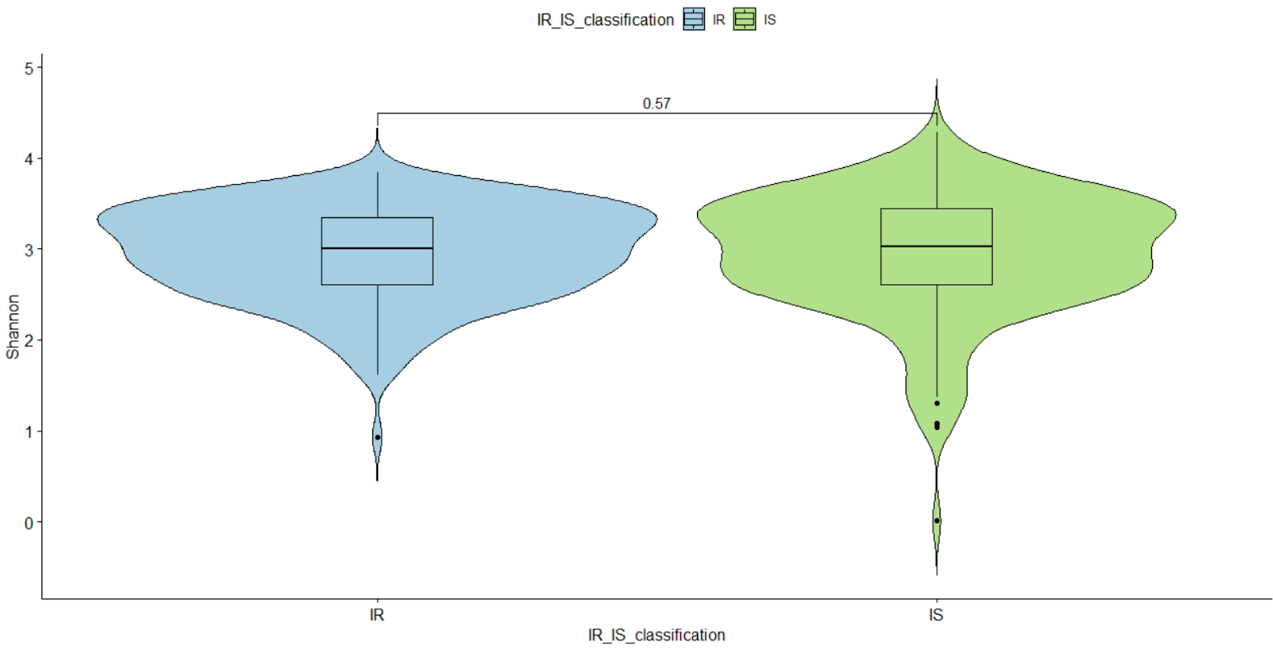
Results: 4 Shannon diversity
17
= measure of species diversity and evenness
Notes:
Species evenness refers to how close in numbers each species in an environment is.
Species abundance is the number of taxa per species

Slide 28
References
International Diabetes Federation. IDF Diabetes Atlas, 9th edn. Brussels, Belgium: 2019. Available at: https://www.diabetesatlas.org
American Diabetes Association. 2. Classification and diagnosis of diabetes: standards of medical care in diabetes—2019. Diabetes Care. 2019 Jan 1;42(Supplement 1):S13-28
Saisho Y. How Can We Develop More Effective Strategies for Type 2 Diabetes Mellitus Prevention? A Paradigm Shift from a Glucose-Centric to a Beta Cell-Centric Concept of Diabetes. DIABETES. 2018 Nov.
Integrative HM. The Integrative Human Microbiome Project: dynamic analysis of microbiome-host omics profiles during periods of human health and disease. Cell host & microbe. 2014 Sep 10;16(3):276.
Ferrannini E, Gastaldelli A, Iozzo P. Pathophysiology of prediabetes. Medical Clinics. 2011 Mar 1;95(2):327-39.
Guillet C, Masgrau A, Walrand S, Boirie Y. Impaired protein metabolism: interlinks between obesity, insulin resistance and inflammation. Obesity Reviews. 2012 Dec;13:51-7.
Sears DD, Hsiao G, Hsiao A, Yu JG, Courtney CH, Ofrecio JM, Chapman J, Subramaniam S. Mechanisms of human insulin resistance and thiazolidinedione-mediated insulin sensitization. Proceedings of the National Academy of Sciences. 2009 Nov 3;106(44):18745-50.
Patti ME, Butte AJ, Crunkhorn S, Cusi K, Berria R, Kashyap S, Miyazaki Y, Kohane I, Costello M, Saccone R, Landaker EJ. Coordinated reduction of genes of oxidative metabolism in humans with insulin resistance and diabetes: Potential role of PGC1 and NRF1. Proceedings of the National Academy of Sciences. 2003 Jul 8;100(14):8466-71.
Gurung M, Li Z, You H, Rodrigues R, Jump DB, Morgun A, Shulzhenko N. Role of gut microbiota in type 2 diabetes pathophysiology. EBioMedicine. 2020 Jan 1;51:102590.

